Slide 1
Pinellas ACS
Hurricane Amaranth Exercise
Mike Drake
Pinellas ACS Training Officer
4/28/2022

Slide 2
Agenda
Exercise Objectives
Scenario
Schedule
Site Survey – Deployment locations
Documentation

Slide 3
Pinellas ACS Hurricane Amaranth Exercise
Objectives
Meet communication objectives defined by Pinellas County
Stage a HSEEP compliant communications exercise
Train Pinellas ACS communicators in skills needed during the approach, landfall, and aftermath of a tropical cyclone
Evaluate individual player performance against AUXCOMM and ARES® Position task book requirements
Notes:
Homeland Security Exercise Evaluation Program

Slide 4
Pinellas ACS Hurricane Amaranth Exercise
Exercise Objectives
Overarching Pinellas County Exercise Objective
“The Pinellas County EOC will establish and maintain multi-agency and multi-jurisdictional communications and coordination during a hurricane response in accordance with Pinellas County’s Comprehensive Emergency Management Plan.”
Pinellas ACS Created 8 exercise objectives to demonstrate compliance with the overarching Pinellas County Objective
  Organizational Capability Targets
  Critical Tasks
  Documented in Exercise Evaluation Guides (EEG)

Slide 5
Pinellas ACS Hurricane Amaranth Exercise
Exercise Objectives
ACS objectives distribute between three venues
  Pinellas County EOC Radio Room
  Emergency Evacuation Shelters
  Incident Communication Centers (ICC)

Slide 6
Pinellas ACS Hurricane Amaranth Exercise
Detailed Exercise Objectives – EOC Radio Room
Objective 1: Establish and maintain voice VHF radio networks that support the exchange of information between the EOC and simulated emergency evacuation shelters.
Exchange tactical and formal message traffic with Pinellas ACS Radio Operators located at
  Objective 2: Simulated emergency evacuation shelters using voice VHF radio networks.
  Objective 8: Simulated ICCs using VHF and 800-MHz voice and VHF Winlink data networks.
Objective 3: Establish and maintain VHF/UHF radio and telephonic voice landline networks that support resource management and tactical message exchanges between
  Pinellas County municipalities
  Deployed ACS resources
  Pinellas County EOC
Objective 4: Exchange tactical and formal message traffic with the state of Florida EOC
  Amateur voice and Winlink digital radio networks
  SHARES voice and SHARES Winlink digital radio networks
  EMnet, MSAT, and TracStar voice satellite networks.
ICC – Incident Communication Centers
SHARES – SHAred RESources
Notes:
Cybersecurity and Infrastructure Security (CISA)

Slide 7
Pinellas ACS Hurricane Amaranth Exercise
Detailed Exercise Objectives – Emergency Evacuation Shelters
Objective 1: Establish and maintain voice VHF radio networks that support the exchange of information between the EOC and simulated emergency evacuation shelters.
Objective 2: Exchange tactical and formal message traffic with Pinellas ACS Radio Operators located at the Pinellas County EOC using voice VHF radio networks.
  Status Reports
  ICS 213 messages

Slide 8
Pinellas ACS Hurricane Amaranth Exercise
Detailed Exercise Objectives – Incident Communication Centers
Objective 5: Emplace, configure, operate, and maintain deployable satellite ground stations that provide services to collocated emergency management personnel
  High speed internet
  Cellular phone
  Voice over Internet Protocol (VoIP) phone services
Objective 6: Emplace, configure, and maintain deployable Communications Command Centers (CommandRunner™) that provide the following services
  VHF/UHF amateur radio voice and data networks
  700 and 800 MHz public safety networks
Objective 7: Emplace, configure, and maintain deployable Communications Command Centers that provide the following services to collocated emergency management personnel
  High speed ethernet and Wi-Fi internet service
  VoIP telephone service to co-located emergency management personnel by using a commercially available cellular service Wide Area Network (WAN) backhaul capability.
Objective 8: Establish and maintain VHF/UHF amateur radio and 800 MHz Public Safety voice and data networks that support resource management and tactical message exchanges between
  Deployed ACS resources
  Pinellas County municipalities
  Pinellas County EOC.

Slide 9
Agenda
Exercise Objectives
Scenario
Schedule
Site Survey – Deployment locations
Documentation

Slide 10
Pinellas ACS Hurricane Amaranth Exercise
Pinellas County Scenario
On May 2, 2022, a cold front moves over the southern Gulf of Mexico. A tropical depression forms, later becoming Tropical Storm Amaranth. The storm strengthens modestly over the next few days, and on May 6, 2022, Hurricane Amaranth makes landfall in Pinellas County as a Category 2 hurricane with winds of 100 mph and surge of 6 – 8 ft.
Exercise Dates
  Pinellas County - May 2nd through May 6th
  Pinellas ACS - May 1st, May 2nd , and May 3rd

Slide 11
Pinellas ACS Hurricane Amaranth Exercise
Detailed Pinellas ACS Scenario
Exercise Divided into Three Operational Periods
  The Approaching Storm
    Sunday May 1st 0900 through Tuesday May 3rd 0730
  EOC Activation
    Tuesday May 3rd 0900 through 1330
  Post Storm
    Tuesday May 3rd 1500 through 1730
ACS Communication Testing Allocated to May 3rd

Slide 12
Pinellas ACS Hurricane Amaranth Exercise
ACS Operational Period One
On Sunday May 1st, 2022
  The National Weather Service issues a bulletin stating that a tropical depression is likely to form in the Southern Gulf of Mexico and that the projected storm track includes Pinellas County.
  ACS RO notifies ACS membership of Level 3 Activation (ALERT) via Pinellas Alert System and ACS Tactical Resource Net is established at level 3
On Monday May 2nd, 2022
  A tropical depression forms, later becoming Tropical Storm Amaranth. There is a high probability that a hurricane will make landfall within Pinellas County.
  As the simulated storm intensifies and land fall probability at Pinellas County increases, ACS RO notifies ACS membership of Level 2 Activation (STAND-BY) via Pinellas Alert System and ACS Tactical-Resource net is established at level 2.
  Late on the evening, the ACS RO notifies the membership via Pinellas Alert that ACS will be transitioning to Level 1 activation (ACTIVATE) at 0700 on the morning of May 3^{rd.}
On the morning of Tuesday May 3rd , 2022
  At 0700, the ACS Tactical-Resource net is established at Level 1.
  ACS Radio Operators scheduled for deployment report to the EOC.

Slide 13
Pinellas ACS Hurricane Amaranth Exercise
ACS Operational Period Two
On Tuesday 3rd, 2022
  Pinellas County orders the mandatory evacuation of zones A, B, and C (simulated); Emergency evacuation shelters are opened; and Incident Communication Center (ICC) equipment is prepositioned.
  On the morning of May 3rd, 2022, the weather has not yet begun to deteriorate, and ACS team members are able to move between their homes, the EOC, and deployment locations without being impacted by the weather.
  ACS Operators report to EOC for operational briefing and deployment instructions
    Up to Six emergency evacuation shelters are opened and staffed by ACS Radio Operators
    Two Incident Communication Centers are prepositioned and staffed by ACS Radio Operators
    EOC Radio Room staffed by ACS Operators
  Teams exchange both tactical and formal message traffic with EOC radio room
  ICC teams establish satellite and cellular services for collocated Emergency Management personnel
  Perform communications tests with Pinellas County Municipalities
  After the storm passes, teams are directed to demobilize and return to the EOC for a Hotwash meeting

Slide 14
Pinellas ACS Hurricane Amaranth Exercise
ACS Operational Period Three
On Tuesday 3rd, 2022 - Afternoon
  Hurricane Amaranth departs Pinellas County, and the weather clears sufficiently to allow personnel onto the roof the public safety complex.
  All internet, cell phone, and land line circuits at the EOC are inoperative requiring the use of Satellite and HF radio circuits for communications with the State of Florida EOC.
  ACS Radio Operators install the TracStar satellite antenna on the roof of the Public Safety Complex
    Confirm proper operation of all EOC red phones
  ACS Radio Operators exchange message traffic with the State of Florida EOC
    HF Amateur Radio Winlink digital messages
    SHARES Winlink digital messages
    EMnet and MSAT systems
  Following restoration of all services, demobilize and conduct hot wash meeting

Slide 15
Agenda
Exercise Objectives
Scenario
Schedule
Site Survey – Deployment locations
Documentation

Slide 16
Pinellas ACS Hurricane Amaranth Exercise
Exercise Planning – Development Schedule
EEG – Exercise Evaluation Guide
MSEL – Master Scenario Event List
Notes:
EEG Created first – Good vehicle to use to create Objectives,

Slide 17
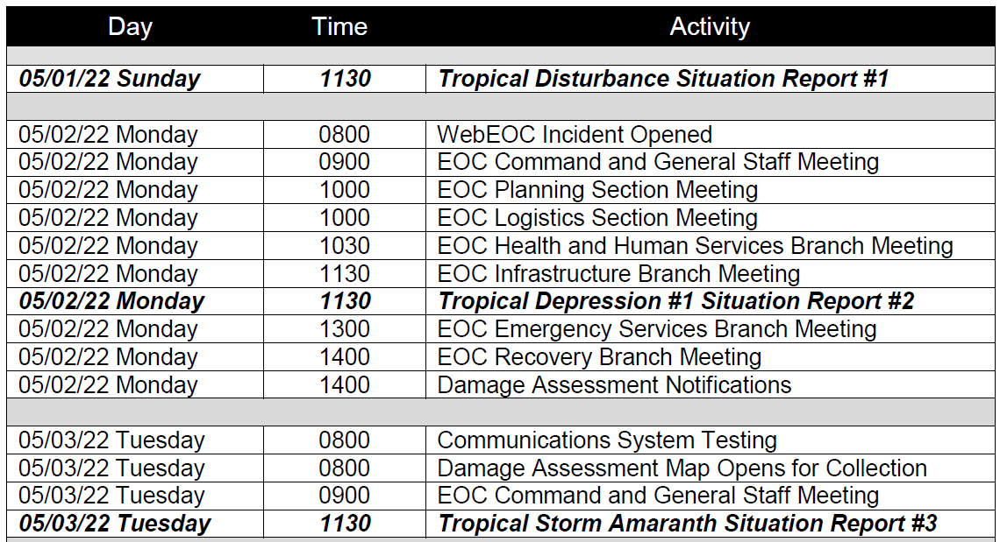
Pinellas ACS Hurricane Amaranth Exercise
Schedule – Day one, Sunday May 1st, 2022
Pinellas County Hurricane Amaranth Exercise Schedule
Pinellas ACS Hurricane Amaranth Exercise Schedule
Day 1: May ^{1st} 2022 | Personnel | Activity | Location
0900 | All Players | StartEx – Begin Operational Period One
1130 | Pinellas EOC Staff | Tropical Disturbance Situation Report #1 | Public Safety Complex
1700 | All Players | ACS RO notifies ACS of Level 3 Activation | Home
1715 | All Players | NCS activates Tactical Resource Net at Level 3 | Home
1730 | All Players | NCS shuts Down Tactical Resource Net | Home
Alignment of County Master Schedule and PACS Exercise Schedule
NCS – Net Control Station
RO – Radio Officer

Slide 18
Pinellas ACS Hurricane Amaranth Exercise
Schedule – Day Two, Monday May 2nd, 2022
Pinellas County Hurricane Amaranth Exercise Schedule
Pinellas ACS Hurricane Amaranth Exercise Schedule
NCS – Net Control Station
RO – Radio Officer

Slide 19
Pinellas ACS Hurricane Amaranth Exercise
Schedule – Day Three, Tuesday May 3rd, 2022
Pinellas County Hurricane Amaranth Exercise Schedule
Schedule Compressed to fit within a single day
  Pre-storm activation and deployment
  Communications support during Incident
  Post-storm communications and demobilization
NCS – Net Control Station
RO – Radio Officer

Slide 20
Pinellas ACS Hurricane Amaranth Exercise
Schedule – Day Three, Tuesday May 3rd, 2022
Day 3: May 3rd 2022 | Personnel | Activity | Location
0700-0730 | Controllers, & Evaluators | Controller and Evaluator Briefing. Check-in for final instructions and communications check. | EOC
0700 | All Players | NCS activates Tactical Resource Net at level 1 and directs all player to depart for EOC. | Home
0730 | All Players | End Operational Period 1
0800-0900 | All Participants | Operational Period 2 Briefing | EOC
0900 | All Players | Conclude Operational Period Briefing, Release players for deployment – Begin Operational Period 2. | EOC
0900-0915 | Shelter Teams | Distribute shelter radios and depart for Simulated shelters. | EOC, Sim shelters
0900 | ICC Teams | Depart EOC for Incident Communications Center | EOC, ICC
0920-1000 | ICC Teams | Arrive at ICC, emplace and configure SatRunner™ CRD™ | ICC
0930-1000 | Shelter Teams | Arrive at Sim shelter location, Set-up equipment, and check-into Shelter net. | Sim Shelters
1000-1030 | ICC Teams | Emplace and configure CommandRunner™ CRD™. | ICC
Day 3: May 3rd 2022 | Personnel | Activity | Location
1000-1130 | Shelter Teams | Exchange both informal and formal voice message traffic with EOC. | Sim Shelters
1030-1100 | ICC Teams | Exchange both informal and formal message traffic with EOC using voice and data nets. | ICC
1100-1130 | ICC Teams | Perform communication tests with Pinellas County municipalities. | ICC
1130-1200 | Shelter Teams | Demobilize shelter site, pack equipment, return to EOC, and return equipment to Logistics officer. | Sim Shelter, EOC
1130-1200 | ICC Teams | Shutdown, pack and ready for transport SatRunner CRD™ and CommandRunner CRD™. | ICC
1200-1215 | ICC Teams | Depart ICC location and return to EOC | ICC, EOC
1230-1330 | All Participants | Hotwash for Operational Periods one and two | EOC
1330 | Operational Period 1 and 2 Players | End Operational Period 2.
1330-1430 | EOC Team B | Break for Lunch
CRD – Compact Rapid Deployable
ICC – Incident Communication Center
NCS – Net Control Station
RO – Radio Officer
Notes:
Message traffic will be managed by using INJECTS. Sealed envelopes with simulated messages (Status reports and ICS 213s)

Slide 21
Pinellas ACS Hurricane Amaranth Exercise
Schedule – Day Three, Tuesday May 3rd, 2022
Post Storm Communication Testing
Day 3: May 3rd 2022 | Personnel | Activity | Location
1430-1500 | EOC Team B | Operational Period 3 Briefing | EOC
1500 | EOC Team B | Conclude Operational Period Briefing – Begin Operational Period 3. | EOC
1500-1530 | EOC Team B | Install the TracStar antenna onto the roof of the Public Safety Complex. | Public Safety Complex Roof
1500-1530 | EOC Team B | Exchange formal digital message traffic with the State of Florida EOC using amateur and SHARES radio frequencies. | EOC Radio Rm
1530-1600 | EOC Team B | Perform satellite communication tests with the state of Florida EOC. | EOC Radio Rm
1530-1600 | EOC Team B | Test operational status of all EOC TracStar Red Phones. | EOC
1600-1630 | EOC Team B | Deinstall and pack the TracStar Antenna. | Public Safety Complex Roof
1630-1730 | EOC Team B | Hotwash | EOC
1730 | All Participants | End Operational Period 3 - EndEx
SHARES – Shared Resources

Slide 22
Agenda
Exercise Objectives
Scenario
Schedule
Site Survey – Deployment locations
Documentation

Slide 23
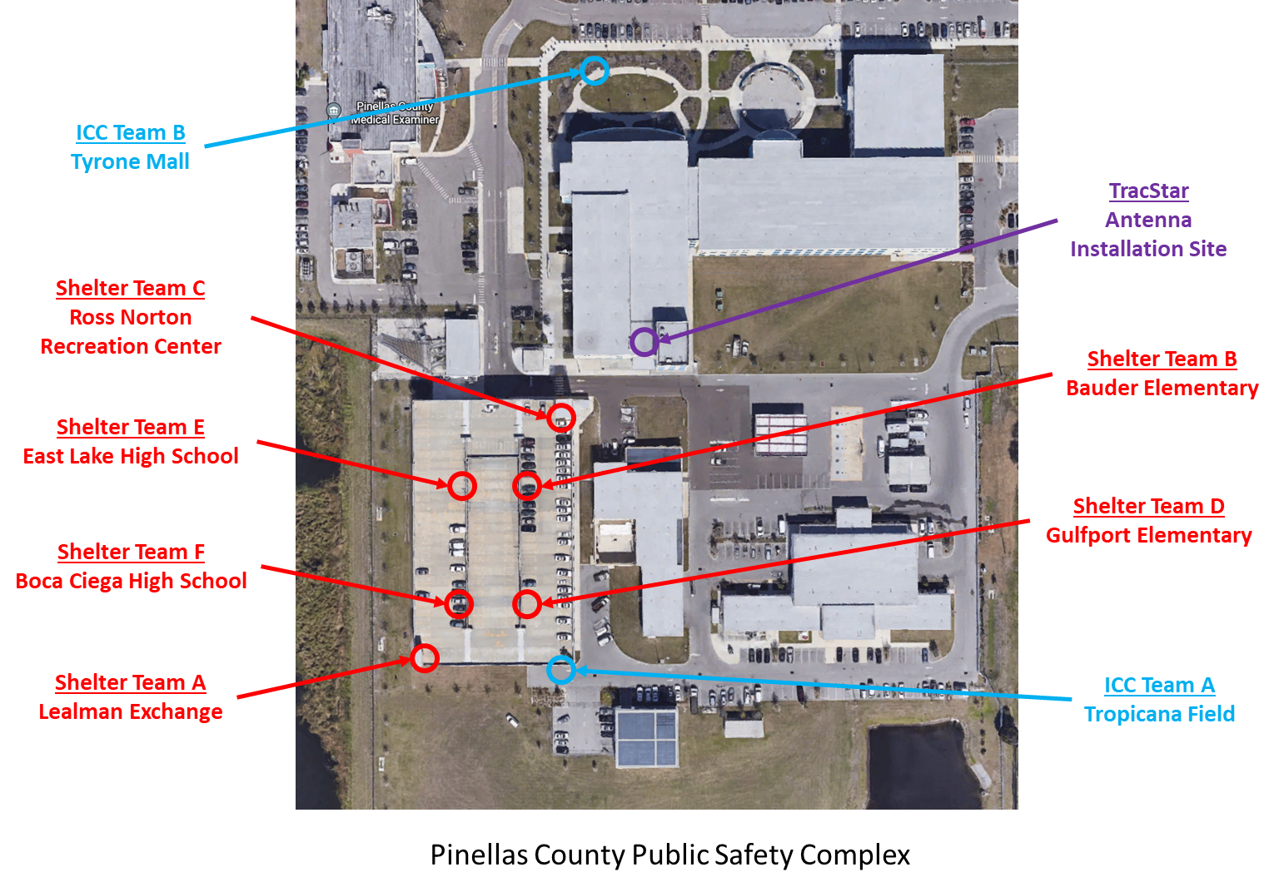
Pinellas ACS Hurricane Amaranth Exercise
Deployment Locations
Site Survey Performed on April 21st
Six simulated shelter locations
  Top Floor of Parking Garage
  Staged prior to exercise with tables and chairs
Two ICC locations
All deployment sites have access to AC Power

Slide 24
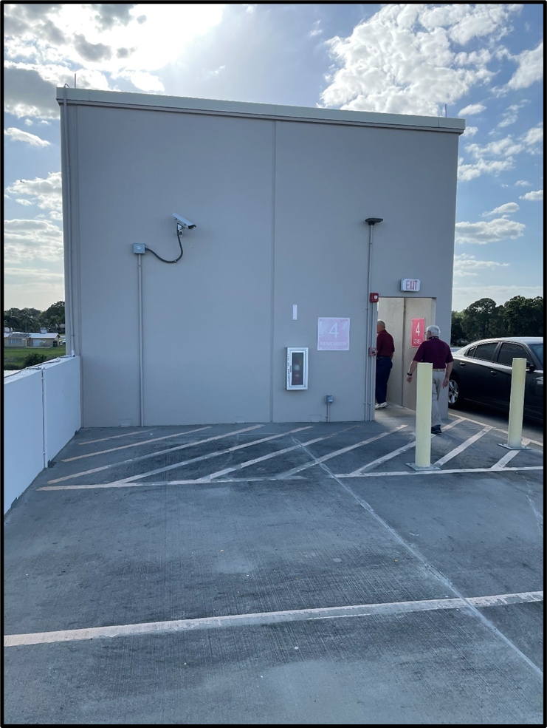
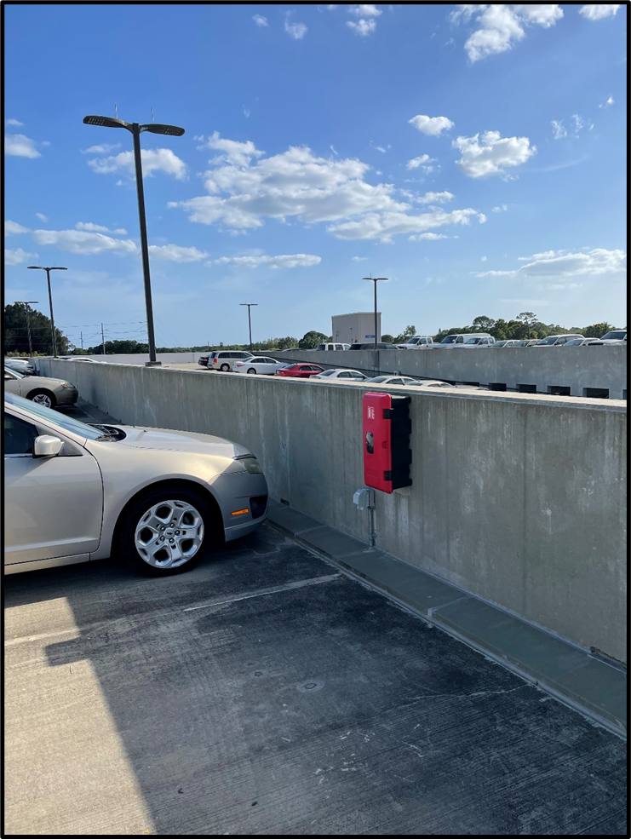
Pinellas ACS Hurricane Amaranth Exercise
Shelter Deployment Locations
AC Power
Outlet
AC Power
Outlet
Southwest Corner
East of Vehicle Ramp

Slide 25
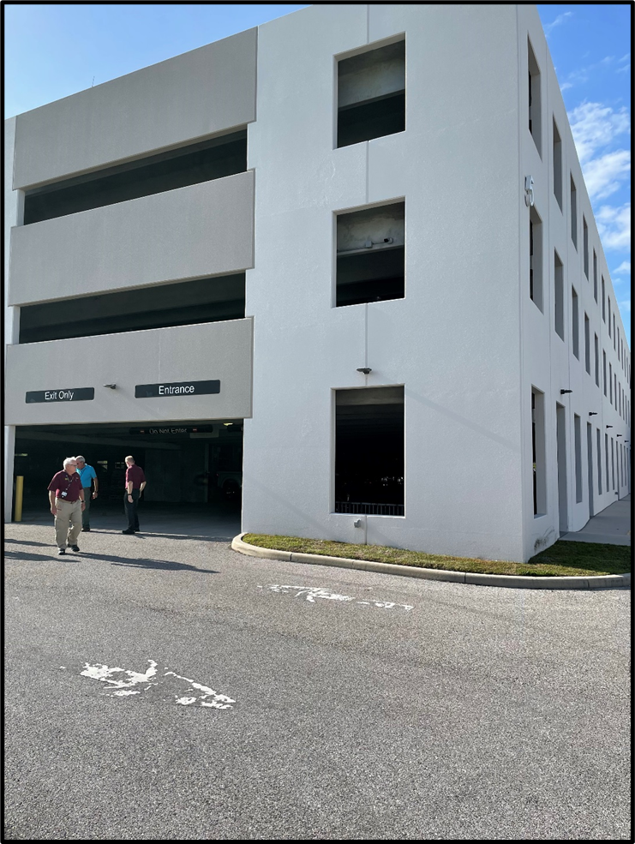
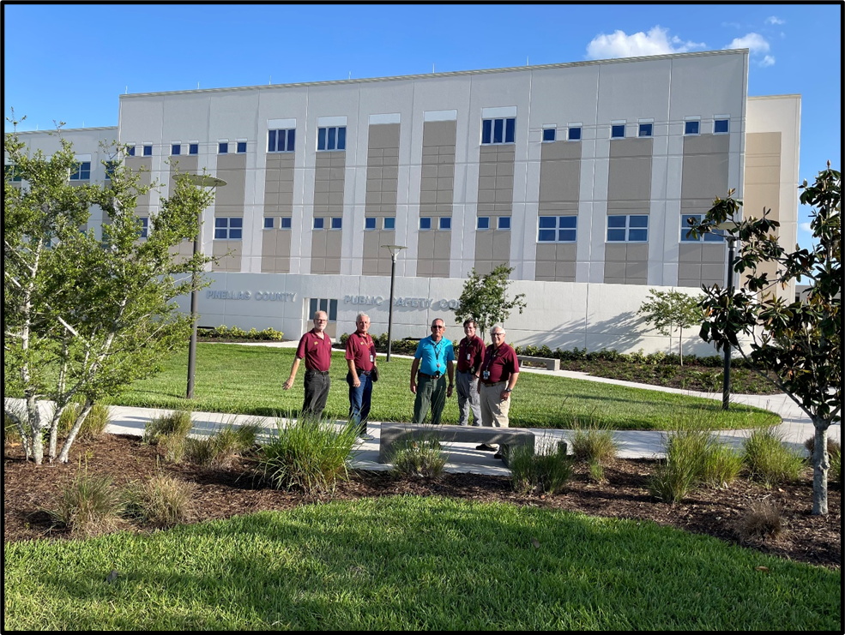
Pinellas ACS Hurricane Amaranth Exercise
ICC Deployment Locations
AC Power
Outlet
AC Power
Outlet
Northwest Front of Complex
Southeast Corner

Slide 26
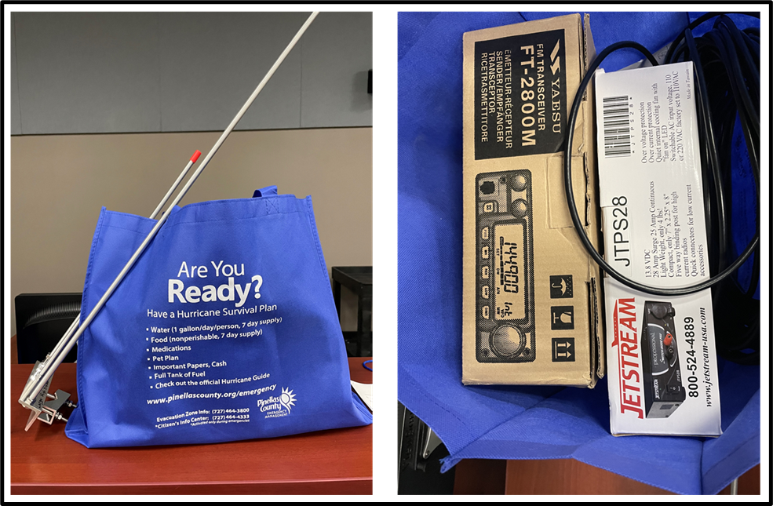
Pinellas ACS Hurricane Amaranth Exercise
Shelter Radio Kit
Shelter Teams will obtain Radio Kits from EOC Cache
  Deploy to Simulated Shelter location
  Unbox, install, configure
  Establish communications with the EOC
Demobilization
  De-install, pack, and transport back to EOC Cache
  Document discrepancies

Slide 27
Agenda
Exercise Objectives
Scenario
Schedule
Site Survey – Deployment locations
Documentation

Slide 28
Pinellas ACS Hurricane Amaranth Exercise
Documentation
Exercise Planning Documents
  Exercise Plan
  Exercise Evaluation Guides
  Master Scenario Event List
  Inject Packets
Exercise Documents
  Incident Action Plan
Post Exercise Documents
  After Action Report and Improvement Plan

Slide 29

Pinellas ACS Hurricane Amaranth Exercise
ACS Exercise Plan
Section 1. Exercise Overview
Section 2. General Information
Section 3. Exercise Logistics
Section 4. Post-exercise Activities
Section 5. Participant Information and Guidance
Appendix A. Communications Plan
Appendix B. Exercise Participants
Appendix C. Exercise Schedule
Appendix D. Exercise Site Maps
Appendix E. Exercise Scenario
Appendix F. Acronyms, Abbreviations, and Definitions

Slide 30
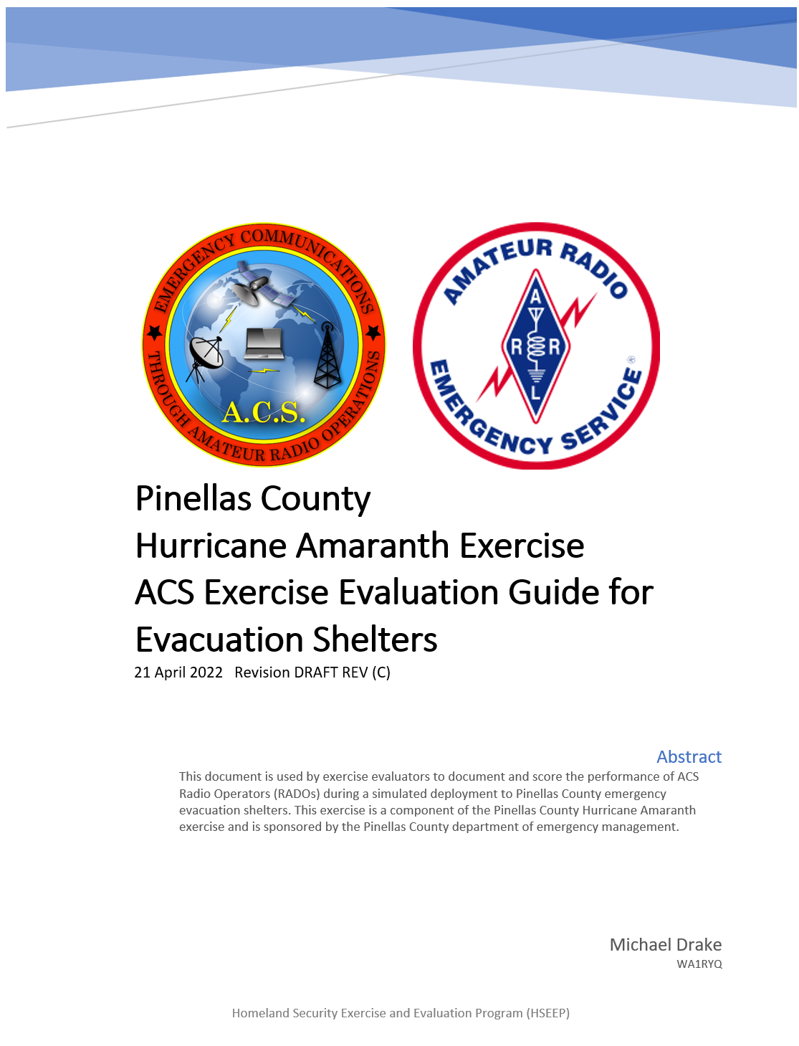
Pinellas ACS Hurricane Amaranth Exercise
Exercise Evaluation Guides (EEG)
One EEG created for each Venue
  Evacuation Shelters
  EOC Radio Room
  Incident Communication Centers
List of tasks required to complete each exercise objective
Used by exercise evaluators
  Document issued uncovered during exercise
  Determine where additional training may be required
  Identify shortfalls in plans, SOPs and Job aids

Slide 31
Pinellas ACS Hurricane Amaranth Exercise
ACS Exercise Evaluation Guide - Sample
    Organizational Capability Target 2.
Within 3 hours of ACS Activation, establish a VHF radio Winlink data network that supports the exchange of information between TBD Pinellas County special needs emergency evacuation shelters and the Pinellas County EOC. Network communications is maintained for the duration of a 72-hour incident.
Table II. Capability Target 2 - EEG Score Sheet
Task ID | Critical Task | AUXC PTB Item | Observation Notes and Explanation of Rating | Target Rating
SCT2T1 | ACS RADO obtains, assembles, and prepares the material for a personal and Winlink digital Go-Kit that will support a 72-hour activation period. | 2a.1, 2a.2, 2a.3, 2a.4 | This task will not be evaluated during the May 2022 Pinellas County Hurricane Amaranth Exercise.
SCT2T2 | When notified of ACS activation (Pinellas Alert, Email, text, or phone), the ACS RADO notifies the ACS RO that he or she is available for activation and accepts evacuation shelter assignment.
SCT2T3 | On an as needed basis, ACS RADO obtains shelter radio kit from EOC.
SCT2T4 | ACS RADO obtains incident specific information regarding the deployment from ACS RO/ Deputy RO (deployment location, duration, time of arrival, ICS 204, ICS 205, etc.) | 2b.1, 2b.2
SCT2T5 | ACS RADO installs and configures shelter radio equipment at emergency evacuation shelter.
AUXC – Auxiliary Communicator
PTB – Position Task Book

Slide 32
Pinellas ACS Hurricane Amaranth Exercise
ACS Exercise Evaluation Guide - Ratings
Performed without Challenges (P) | The targets and critical tasks associated with the core capability were completed in a manner that achieved the objective(s) and did not negatively impact the performance of other activities. Performance of this activity did not contribute to additional health and/or safety risks for the public or for emergency workers, and it was conducted in accordance with applicable plans, policies, procedures, regulations, and laws.
Performed with Some Challenges (S) | The targets and critical tasks associated with the core capability were completed in a manner that achieved the objective(s) and did not negatively impact the performance of other activities. Performance of this activity did not contribute to additional health and/or safety risks for the public or for emergency workers, and it was conducted in accordance with applicable plans, policies, procedures, regulations, and laws. However, opportunities to enhance effectiveness and/or efficiency were identified.
Performed with Major Challenges (M) | The targets and critical tasks associated with the core capability were completed in a manner that achieved the objective(s), but some or all of the following were observed: demonstrated performance had a negative impact on the performance of other activities; contributed to additional health and/or safety risks for the public or for emergency workers; and/or was not conducted in accordance with applicable plans, policies, procedures, regulations, and laws.
Unable to be Performed (U) | The targets and critical tasks associated with the core capability were not performed in a manner that achieved the objective(s).

Slide 33
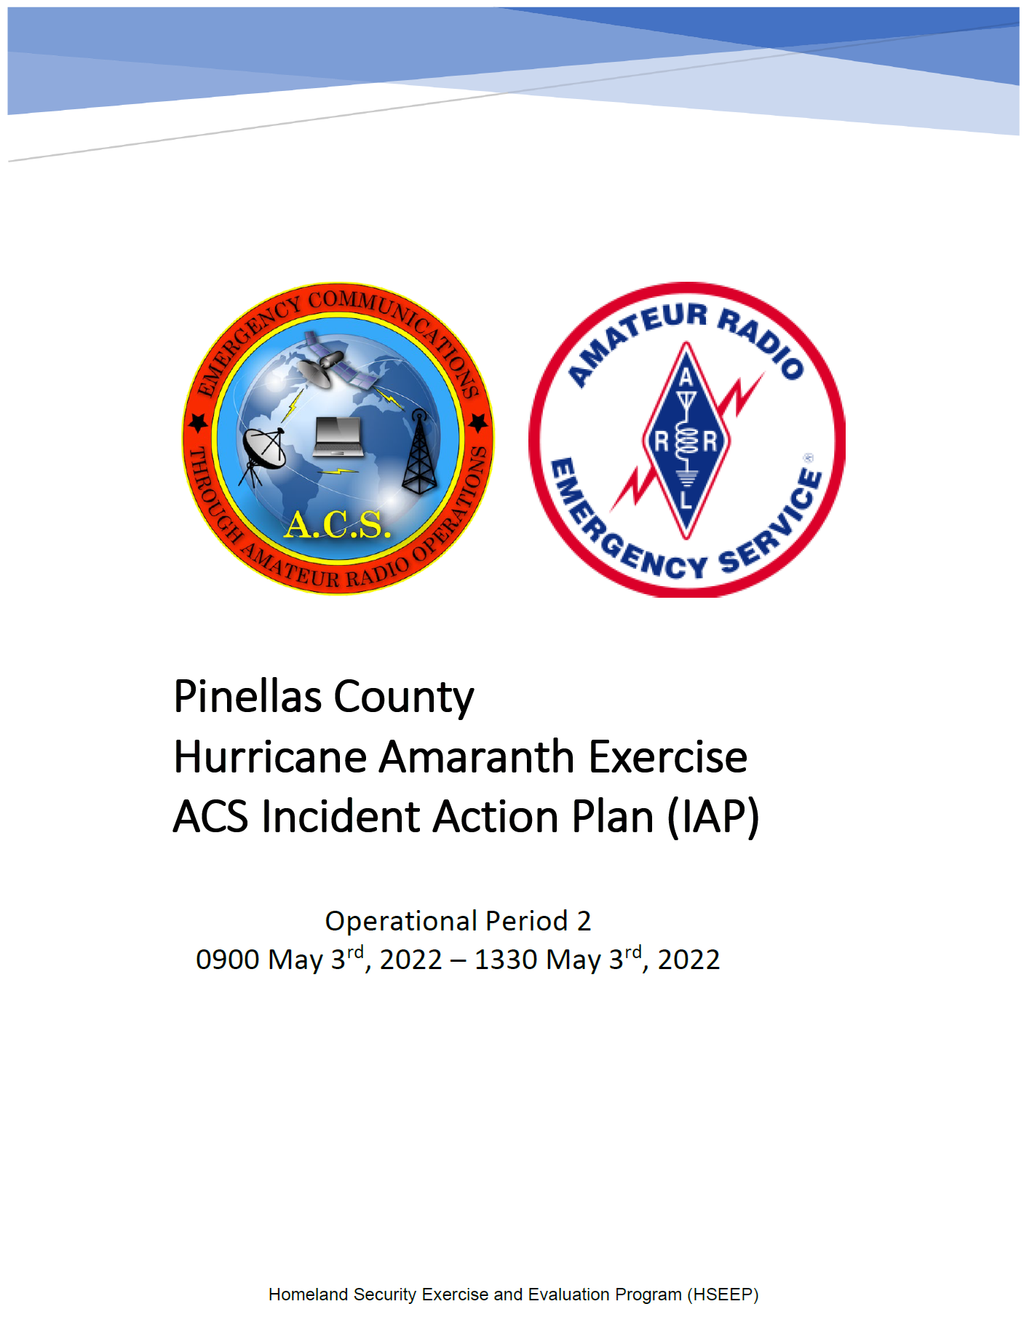
Pinellas ACS Hurricane Amaranth Exercise
Incident Action Plan
ICS 202 Incident Objectives
ICS 204 Assignment Lists
  Pinellas EOC Radio Room
  Evacuation Shelters
  Incident Communication Centers
ICS 205 Incident Radio Communications Plan
ICS 205A Communications List
ICS 207 Incident Organizational Chart
Maps/Charts
  Simulated Evac Shelter and ICC deployment Locations

Slide 34
Pinellas ACS Hurricane Amaranth Exercise
Conclusion
Meet communication objectives defined by Pinellas County
Stage a HSEEP compliant Communications Exercise
Train Pinellas ACS communicators in skills needed during the approach, landfall, and aftermath of a tropical cyclone
Evaluate individual player performance against AUXCOMM and ARES® Position task book requirements
Questions?

Slide 35
Back-up

Slide 36
Pinellas ACS Hurricane Amaranth Exercise
Master Scenario Event List (MSEL)
Event | Date | Time | Category | Inject Mode | Inject ID | Event Description | Responsible Player | Recipient Player(s) | Expected Action/Outcome
COMMON - ALL PLAYERS
 | 5/1/2022 |  |  |  |  | Sunday May 1st, 2022
COM-1 | 5/1/2022 | 900 |  |  |  | Start Exercise - Begin Operational Period One
COM-2 | 5/1/2022 | 1130 | Expected Action |  |  | Tropical Disturbance Situation Report #1 | Pinellas Co DEM
COM-3 | 5/1/2022 | 1700 | Inject | Pinellas Alert | PA-1 | Notify ACS membership of Level 3 exercise activation via Pinellas Alert, Text, and/or phone. | ACS RO/Deputy | All RADOs | All ACS RADOs respond to notification with deployment availability status.
COM-4 | 5/1/2022 | 1700-1715 | Expected Action |  |  | Direct NCS to establish Tactical Resource net at activation level 3 (Exercise) | ACS RO/Deputy | NCS - Tac-Rsrc Net | 1. NCS Establishes Tactical Resource Net at Activation Level 3 (exercise) on the W4ACS Repeater 2. NCS uses proper net control script
COM-5 | 5/1/2022 | 1730 | Expected Action |  |  | Tactical Resource net is shut down after 15 minutes of operation. | NCS - Tac-Rsrc Net
 | 5/2/2022 |  |  |  |  | Monday May 2nd, 2022 - Continuation of Operational Period One
COM-6 | 5/2/2022 | 1130 | Expected Action |  |  | Tropical Depression #1 Situation Report #2 | Pinellas Co DEM | ACS RO/Deputy | Pinellas County DEM notifies ACS RO/ ACS RO Deputy of Hurricane within the 5 day cone.
COM-7 | 5/2/2022 | 1200 | Inject | Pinellas Alert | PA-2 | Notify ACS membership of Level 2 exercise activation via Pinellas Alert, Text, and/or phone. | ACS RO/Deputy | All RADOs | All ACS RADOs respond to notification with deployment availability status.
COM-8 | 5/2/2022 | 1200 | Expected Action |  |  | Direct NCS to establish Tactical Resource net at activation level 2 (Exercise) | ACS RO/Deputy | NCS - Tac-Rsrc Net | NCS agrees to establish tactical resource net.
COM-9 | 5/2/2022 | 1200-1215 | Expected Action |  |  | Establishes Tactical Resource Net at Activation Level 2 (Exercise) on the W4ACS Repeater and take net check-ins. | NCS - Tac-Rsrc Net | All RADOs | 1.NCS uses proper net control script 2. All ACS RADOs scheduled to take part in the exercise check-in to the Tactical Resource net and advise net control of availability to deploy during exercise.
COM-10 | 5/2/2022 | 1200-1230 | Inject | Tactical Radio | TR-1 | Direct EOC and ICC team leads to generate an ICS 205 for upcoming Exercise and Deliver via Email to ACS RO. | NCS - Tac-Rsrc Net | EOC ACS RADO | Each EOC ACS RADOs develop ICS 205 for exercise and deliver to ACS RO via Email.
COM-11 | 5/2/2022 | 1215-1245 | Expected Action |  |  | Tactical Resource net is shut down after all RADOs check into the net with expected status. | NCS - Tac-Rsrc Net | All RADOs | All ACS RADOs secure for the evening.

Slide 37
Pinellas ACS Hurricane Amaranth Exercise
Work Assignments – EOC Radio Room

Slide 38
Pinellas ACS Hurricane Amaranth Exercise
Work Assignments – Shelter Teams

Slide 39
Pinellas ACS Hurricane Amaranth Exercise
Work Assignments – ICC Teams

